Slide 1
Introduction to Accounting
Meaning of Accounting:
Accounting is a systematic process of identifying, measuring, recording, classifying, summarising, interpreting and communicating financial information to the users.

Slide 2
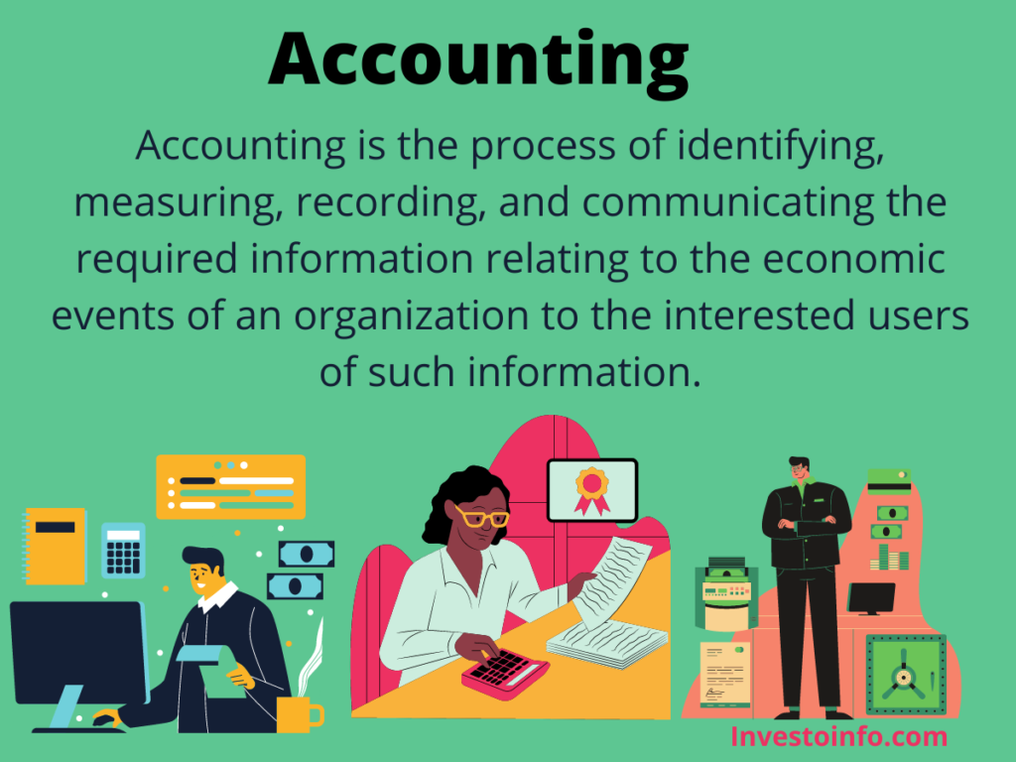

Slide 3
It gives information on:
i. the resources available;
Ii. How the available resources have been employed; and
Iii. The results achieved by their use.
It shows the profit earned or loss incurred during the period, value and nature of assets, liabilities and owners’ equity, i.e. capital.

Slide 4
Since accounting is a medium of communication, it is called the language of business.

Slide 5
Business
There are two types of Activities in Business/Organisations.
A. Financial Activities/ Transactions/Events(Financial Transactions)
B. Non- Financial Activities

Slide 6
Financial Transactions: Those transactions which can be measured in monetary value i.e. called Financial transactions. It is also called Economic activities.
Activities. E.g. Purchase goods Rs. 60,000.
Sale of goods Rs. 70,000
Salary paid to staff Rs. 30,000.
These transactions to be recorded in the books of Account.

Slide 7
Non-Financial Transactions: eg. Good relation between manager and workers,
Workers strike on the gate of factory etc.
Non –Economic Activities are not recorded in the books of account because it cannot be measured in money value.

Slide 8
2. Objectives of Accounting
1. Record of Financial Transactions & Events
2. Determine Profit or Loss
3. Determine Financial Position (Balance- sheet)
4. Assisting the Management
5. Communicating Accounting Information to Users
6. Protecting Business Assets

Slide 9
Advantages of Accounting
Maintenance of business records.
Preparation of financial statements.
Comparison of results.
Decision making.
Evidence in legal matters.
Provides information to related parties.
Helps in taxation matters.
Valuation of business.

Slide 10
Qualitative Characteristics of Financial Statement
Understandability
Relevancy
Reliability
Materiality
Comparability

Slide 11
3. Limitations of Accounting
1. Accounting Ignores the Qualitative Elements
2. Accounting may Lead to window Dressing
3. Accounting is not Fully Exact
4. Accounting does not Indicate the Realisable Value
5. Accounting Ignores the Effect of Price Level Changes

Slide 12
Scope of Accounting
The scope of Accounting is wide and extends in business, trade, government, financial institutions, individuals and families and every other arena. ... The functions of Accounting are to keep accounts of those financial transactions. Even accounts are to be kept in case of individuals and families.

Slide 13
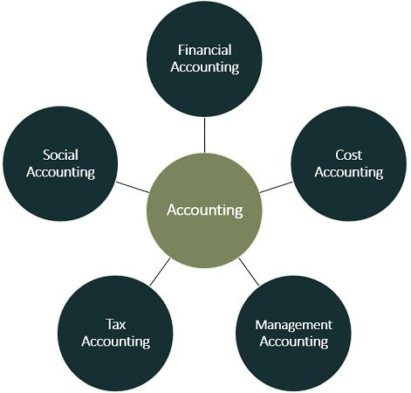
Branches of Accounting

Slide 14
4. Branches of Accounting
A. Financial Accounting
B. Cost accounting
C. Management Accounting

Slide 15
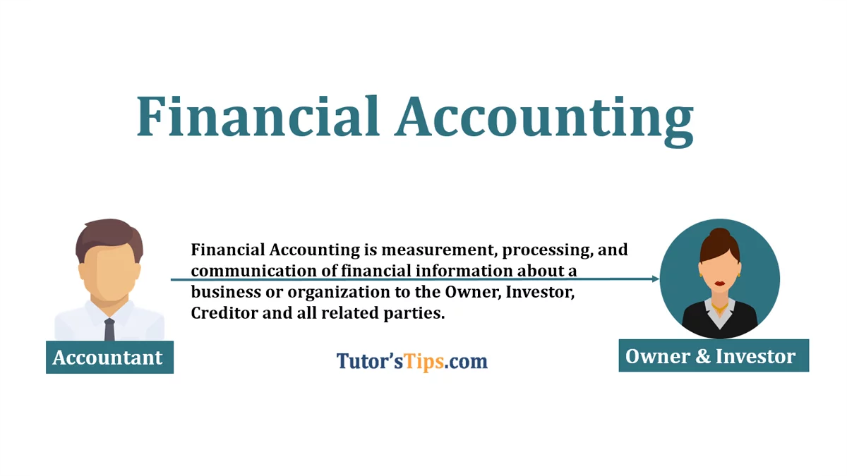

Slide 16
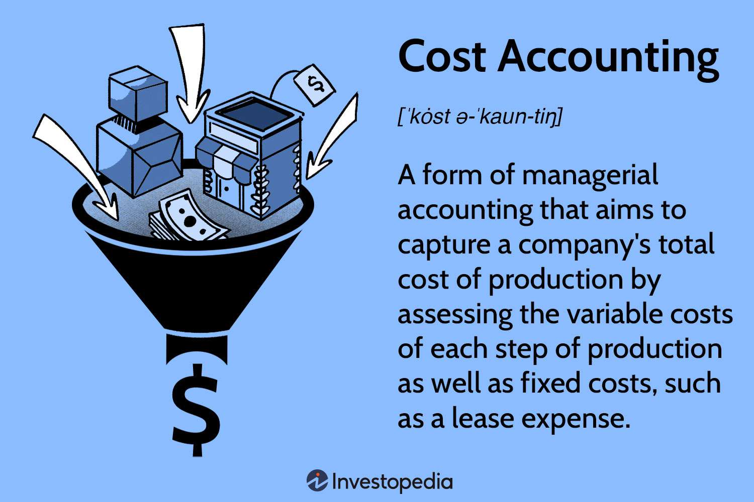

Slide 17
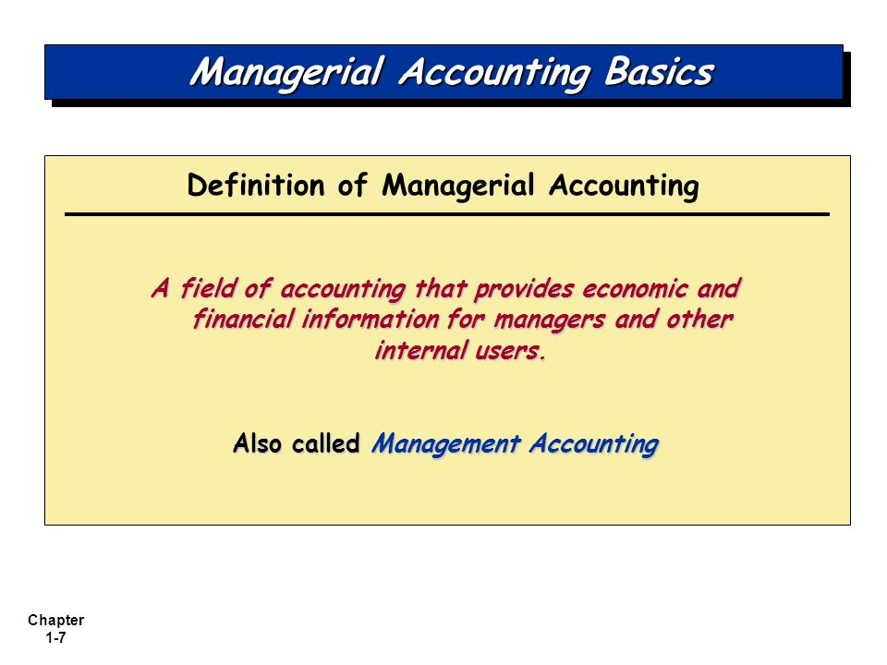

Slide 18
Meaning of Book Keeping
Book Keeping is a part of accounting being a process of recording of financial transactions and events in the books of accounts.
Difference Between Book Keeping And Accounting:
1. Scope 2.Stage 3. Objecting 4. Nature of job
5. Performance 6. Special Skills

Slide 19
5. Users of Accounting Information
Internal Users
Owners : Owners contribute capital in the business .
Management : The management makes extensive use of accounting information to arrive at informed decisions such as determination of selling price , cost controls etc.
Employees and workers

Slide 20
B. External users
(i) Banks and Financial Institutions
(ii) Investors and Potential Investors
Creditors:
Government:
Researchers:
Consumers:
Public :
Media

Slide 21
Systems of accounting
1. Double Entry System
2. Single Entry System
Features of Double Entry System
It maintains a complete record of each transaction.
it recognises two- fold aspect of every transaction, viz.; the aspect of receiving (value in) and the aspect of giving (value out)

Slide 22
Advantages of double entry system
Scientific system
Complete record of transactions
Comparative study is possible
Helps management in decision making

Slide 23
Basics Accounting Terms:
Assets
Capital
Liabilities
Income
Expenses
Debtors
Creditors

